Slide 1

About the Presentations
The presentations cover the objectives found in the opening of each chapter.
All chapter objectives are listed in the beginning of each presentation.
You may customize the presentations to fit your class needs.
Some figures from the chapters are included. A complete set of images from the book can be found on the Instructor Resources disc.

Slide 2

Principles of Program Design: Problem Solving with JavaScript
Chapter 1
The Craft of Programming

Slide 3
Objectives
In this chapter, you learn to:
Explain computer programming and what it includes
Describe how data and instructions are stored in the computer
Explain the difference between hardware and software, with examples of each
Summarize the basic operating functions of the central processing unit, memory, and storage drives

Slide 4
Objectives (cont’d.)
Describe an algorithm and name some tools for developing one
Describe methods for testing programs
Name the two main data types a programmer uses and give an example of each
Define the binary and decimal numbering systems and convert a number from one system to another
Explain the difference between the two main character-coding systems: ASCII and Unicode

Slide 5
Objectives (cont’d.)
Define variables and named constants and explain how to declare them and assign values to them
Define and contrast input and output
Explain the need for and use of program comments
Describe the input-output-processing method
Use pseudocode to begin solving a problem by developing an algorithm

Slide 6
What Is Computer Programming?
Formulating computer instructions
Bits: binary digits (zeros and ones)
Machine language
  Computer’s basic instructions
  Consists of bit sequences
Data
  Raw information processed by computers

Slide 7
What Is Computer Programming? (cont’d.)
Software
  Computer programs
Hardware
  Computer and its related equipment
Two parts of the central processing unit (CPU)
  Control unit (traffic manager)
    Fetch, decode, execute, store
  Arithmetic logic unit (calculator)
    Arithmetic portion performs mathematical calculations
    Logic portion compares two values

Slide 8
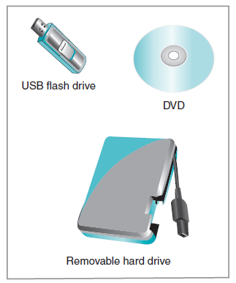
What Is Computer Programming? (cont’d.)
Random access memory (RAM)
  Main, volatile memory
Read-only memory (ROM)
  Persistent memory
Long-term storage
  Disk drives
  Storage media
Figure 1-2 Examples of storage devices

Slide 9
Programming Skills: Using the Right Tool for the Right Job
Algorithms: the logic of problem solving
  First understand the problem
  Formulate the steps used (the algorithm)
  Characteristics of algorithms
    Correct
    Efficient
    Easy to understand
  Pseudocode
    Structured, English-like language to describe steps

Slide 10
Programming Skills: Using the Right Tool for the Right Job (cont’d.)
Testing your programs
  Can be done at several levels:
    Small sections of program code (snippets)
    Task-oriented modules
    Interaction between modules
    Complete programs
    Interaction between programs

Slide 11
Programming Skills: Using the Right Tool for the Right Job (cont’d.)
Testing your programs (cont’d.)
  Data sets
    Used to see how program behaves at data boundaries
    Use valid and invalid data

Slide 12
Programming Skills: Using the Right Tool for the Right Job (cont’d.)
Types of errors
  Syntax error
    Violation of language rules
  Logic error
    Incorrect instructions
  Runtime error
    Not known until the program runs
    Example: missing data file

Slide 13
Programming Basics
Data types and numbering systems
Categories of data
  Numeric
  Text
  Raw binary
Decimal numbering system
  Base 10
Binary numbering system
  Base 2

Slide 14
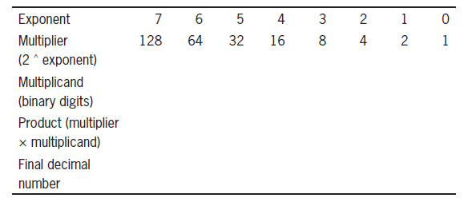
Programming Basics (cont’d.)
Converting binary numbers to decimal
Table 1-3 Binary-to-decimal conversion table

Slide 15
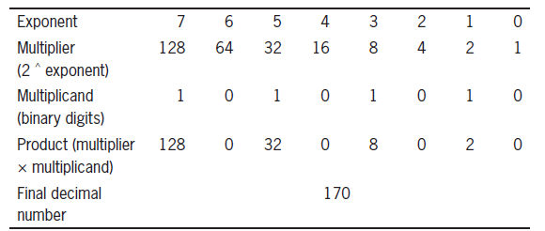
Programming Basics (cont’d.)
Example: converting 10101010 to its decimal equivalent, 170
Table 1-5 Converting binary 10101010 to its decimal equivalent

Slide 16
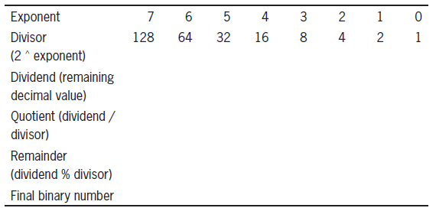
Programming Basics (cont’d.)
Converting decimal numbers to binary
Table 1-7 Decimal-to-binary conversion table

Slide 17
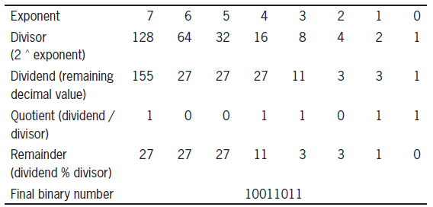
Programming Basics (cont’d.)
Example: converting decimal 155 to its binary equivalent
Table 1-8 Converting decimal 155 to its binary equivalent

Slide 18
Programming Basics (cont’d.)
Character-coding systems
  American standard code for information interchange (ASCII)
    Eight bits used to represent each character
  Unicode
    Sixteen bits are used (first eight match ASCII)
    Developed to address needs of non-English language alphabets

Slide 19
Programming Basics (cont’d.)
Variables and named constants
  Computer names for memory locations
Values
  Stored in memory locations
Declaring a variable
  Associating a name with a data type
  Two data types used here: numeric and string

Slide 20
Programming Basics (cont’d.)
Numeric variables
  Can store any type of number
  With or without decimal places
String variables
  Store text
  Single character
  Collection of characters
  Empty string " "

Slide 21
Programming Basics (cont’d.)
Assignment statement
  Variable name = value
Rules for variable names
  May include digits, letters, underscores, and hyphens
  May not begin with a digit
  May not contain spaces
  Should be easy to read and understand
Named constant
  Value can’t be changed while program runs

Slide 22
Programming Basics (cont’d.)
Literals: constant values
Empty string: blank spaces between quotation marks
Assignment statement examples:
  homeState = “Florida”
  semesterGPA = 3.89
  itemCost02 = itemCost01

Slide 23
Programming Basics (cont’d.)
Numeric operations
  Addition (+)
  Subtraction (-)
  Multiplication (*)
  Division (/)
  Modulus (%)
    Calculates the remainder value

Slide 24
Programming Basics (cont’d.)
Order of operations
  Parentheses indicate operation to be done first:
    totalCost = 5 + (2 * 40) + (3 * 20)
  Exponents
  Multiplication and division, left to right
  Addition and subtraction, left to right
String operations
  Concatenation:
    addrLine1 = firstName + " " + lastName

Slide 25
Programming Basics (cont’d.)
Input and output
Input gathered in two main ways
  User enters values
  Values are read from a file or database
Output
  Screen output is called soft copy
  Printed output is called hard copy

Slide 26
Programming Basics (cont’d.)
Program comments
  Aids others’ understanding of the program
  Not executed by the computer
  Consistent
  Brief
  Describe what a program section accomplishes
  Use comments as variable names are declared

Slide 27
Programming Basics (cont’d.)
The input-processing-output method
  Output: what the program delivers
  Input: available information
  Processing steps convert input to output

Slide 28
Programming Basics (cont’d.)
Chapter example: print a payroll statement
  Identify outputs
    Gross pay and net pay
  Identify inputs
    Employee’s name, hours worked, wage rate, and total deductions
  Identify processing steps
    Multiply hours by wage rate
    Subtract total deductions

Slide 29
Programming Basics (cont’d.)
Chapter example (cont’d.)
  Determine variables needed
  Write pseudocode
    Long statements can occupy two lines
    Indent second line for easier reading
  Include comments

Slide 30
Summary
Computer programs are created to solve problems
Algorithm: steps to solve a problem
  Pseudocode outlines the processing steps
Key components of a computing system
  Hardware, software, memory, storage
Two numbering systems: binary and decimal
Character-coding systems: ASCII and Unicode

Slide 31
Summary (cont’d.)
Variables and named constants store values
  Numeric and string data types
Testing programs done in small code sections
Include comments to aid understanding

